Slide 1
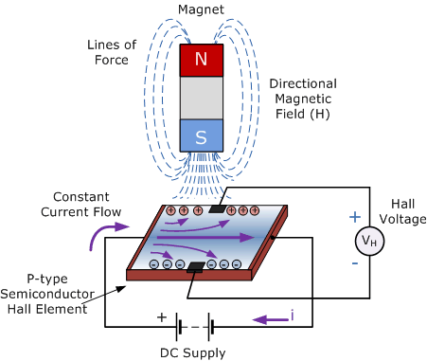
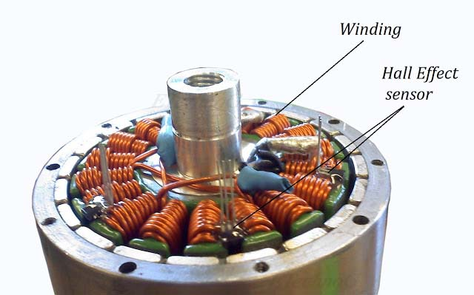
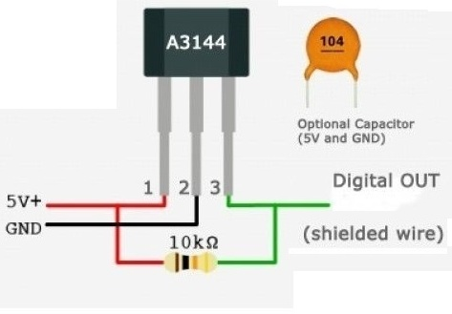
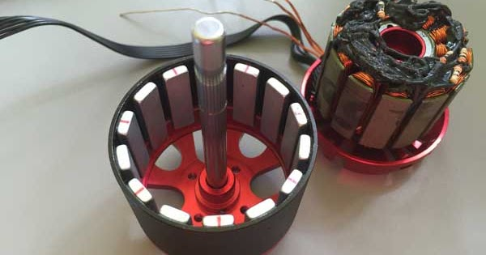
Actuators – 3.4
Brushless DC Motors
FY – DESH – VIT
Vishwakarma Institute of Technology
FY - Department of Engineering, Sciences and Humanities

Slide 2
Merits of DC Brush motors –
1) Speed control over a wide range is possible.
2) Very high HP capacity motors are available.
3) Relatively ease of speed control.
4) Moderate technology power supply and starters are sufficient.
5) High expertise not required for maintenance.
6) Cheap and cost effective.
Vishwakarma Institute of Technology
FY - Department of Engineering, Sciences and Humanities

Slide 3
Demerits of DC Brush motors –
At the Commutator, the brushes are continuously having friction. This causes wear and tear of the brushes as well as the commutator segments.
2) Maintenance cost increases.
3) Heat produces carbon particles at the brush contacts.
4) Frequent replacement of brushes is required.
5) Voltage drop takes place at the brush contacts.
6) To prevent high inrush of current at start.
7) A separate DC power supply is required.
8) Noisy operation.
Vishwakarma Institute of Technology
FY - Department of Engineering, Sciences and Humanities

Slide 4
Features of BLDC motors –
To overcome the problems arising of brush contact issues, BLDC motors are developed.
No Left Hand Rule….! Rather, working is based on just a simple Attraction – Repulsion principle between N and S poles.
BLDC motors with or without (Hall effect) sensors are available.
A specialised motor driver circuit is required.
Quiet operation.
Moderate and small capacity motors.
High power to weight ratio.
Good electronic and software control.
Low maintenance.
Vishwakarma Institute of Technology
FY - Department of Engineering, Sciences and Humanities

Slide 5
Vishwakarma Institute of Technology
FY - Department of Engineering, Sciences and Humanities

Slide 6
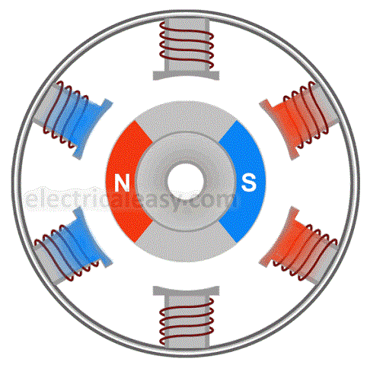
2 Rotor poles
(N and S)
(Permanent)
6 Stator poles (Temporary)
Working Principle –
Vishwakarma Institute of Technology
FY - Department of Engineering, Sciences and Humanities
When the stator poles are excited, attraction takes place between opposite poles of stator and rotor, which gives rise to rotation.
When the rotor pole approaches an opposite pole of stator, that stator pole is switched off and next stator pole is excited.
Thus the rotor pole keeps on chasing stator pole but never becomes successful ….!

Slide 7
BLDC Motor
S
N
N
S
Vishwakarma Institute of Technology
FY - Department of Engineering, Sciences and Humanities
S
N

Slide 8
BLDC Motor
S
N
N
S
Vishwakarma Institute of Technology
FY - Department of Engineering, Sciences and Humanities
S
N

Slide 9
BLDC Motor
S
N
N
S
Vishwakarma Institute of Technology
FY - Department of Engineering, Sciences and Humanities

Slide 10
BLDC Motor
The Rotor pole keeps chasing the opposite pole of the Stator
S
N
S
N
N
S
The motor Driver circuit changes the stator polarity at correct moment.
N
S
Vishwakarma Institute of Technology
FY - Department of Engineering, Sciences and Humanities
N
S
Thus, to know exact location of the rotor pole, Hall effect sensor is required.
N
S

Slide 11
BLDC Motor
S
N
N
S
Vishwakarma Institute of Technology
FY - Department of Engineering, Sciences and Humanities
S
N

Slide 12
Vishwakarma Institute of Technology
FY - Department of Engineering, Sciences and Humanities

Slide 13
Features of Hall effect sensor –
Working –
Hall effect – When a current carrying conductor is subjected to a magnetic field which is perpendicular to the flow of electric current, an EMF, which is at right angle to the path of the flow of current, changes.
Thus, the sensor senses this EMF and can detect existence of a magnetic field in the vicinity if it.
Vishwakarma Institute of Technology
FY - Department of Engineering, Sciences and Humanities

Slide 14
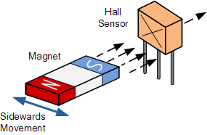
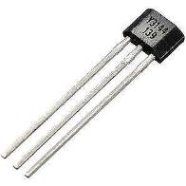
Hall effect sensor in BLDC motor –
Vishwakarma Institute of Technology
FY - Department of Engineering, Sciences and Humanities
Pin configuration and terminals of Hall effect sensor (3144)

Slide 15
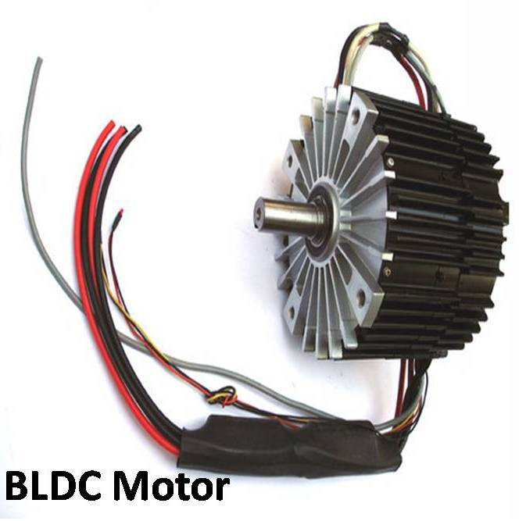
Vishwakarma Institute of Technology
FY - Department of Engineering, Sciences and Humanities

Slide 16
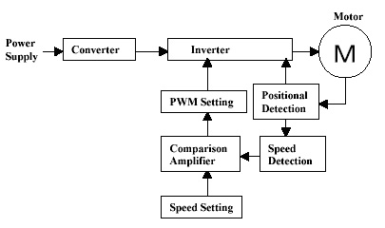
Driver for BLDC motor –
What is a driver circuit ? – As the rotor approaches the stator pole, it is necessary to change the polarity of the stator pole at right time. So that the rotor will advance further and chase the stator pole. Thus, the position of the rotor should be known.
S
N
N
S
S
N
Vishwakarma Institute of Technology
FY - Department of Engineering, Sciences and Humanities
This is done by the Hall effect sensor and accordingly the stator pole is changed. The electronic circuit switching the stator poles is called as the driver circuit.

Slide 17
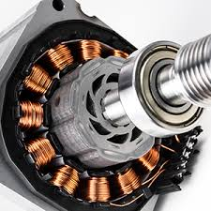
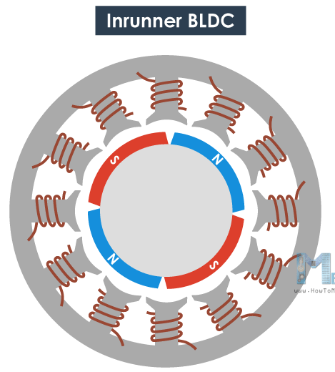
Types of BLDC motors –
1) Inrunner motor – The rotor carries the permanent magnet poles on it and it is surrounded by the stator with wound pole winding on it.
Outer stator with wound poles
Vishwakarma Institute of Technology
FY - Department of Engineering, Sciences and Humanities
Inner rotor with permanent poles

Slide 18
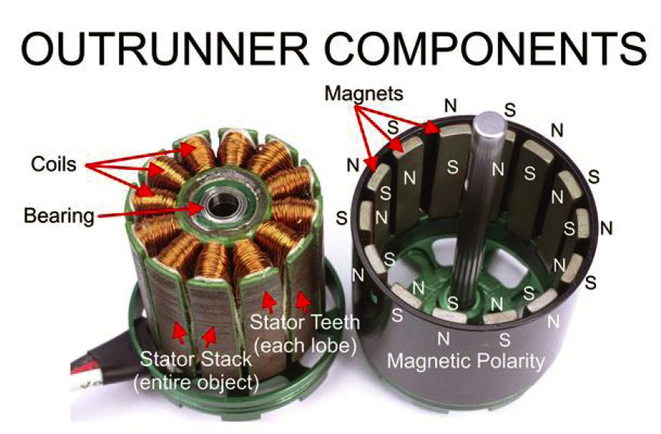
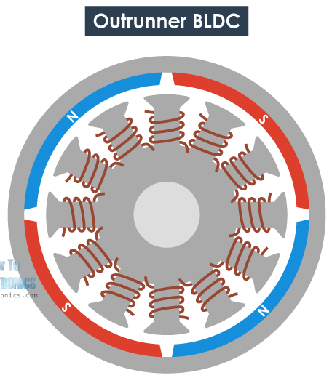
Types of BLDC motors –
2) Outrunner type – The rotor with permanent magnet poles is outside and surrounds the stator with coils in it mounted on the shaft.
Vishwakarma Institute of Technology
FY - Department of Engineering, Sciences and Humanities

Slide 19
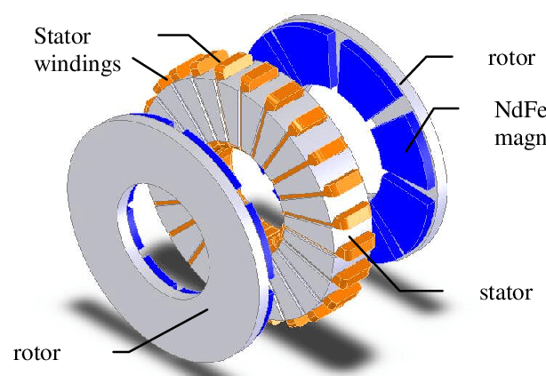
Types of BLDC motors –
Axial flux BLDC motor or Flat motor
3) Axial flux or Flat motor – The stator and rotor are mounted parallel to each other and face to face. Generally used where there are space constraints. These motors are also called as “Pan Cake” motors.
Stator coils are always stationary in all the 3 types.
Vishwakarma Institute of Technology
FY - Department of Engineering, Sciences and Humanities

Slide 20
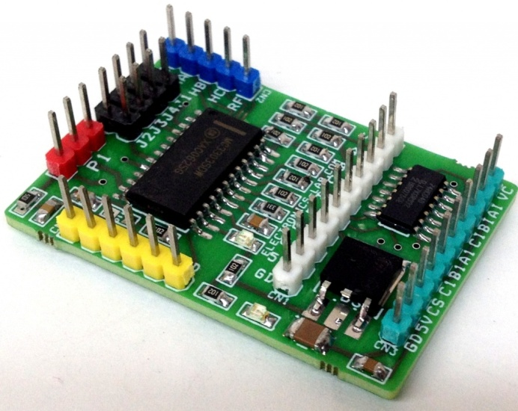
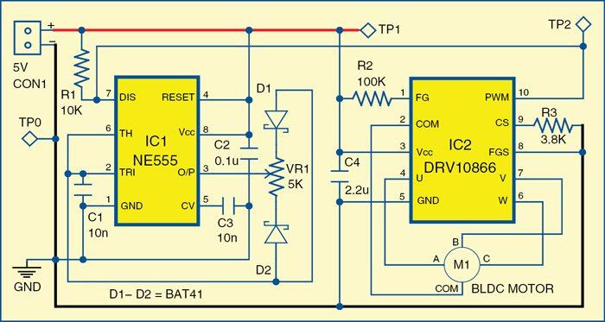
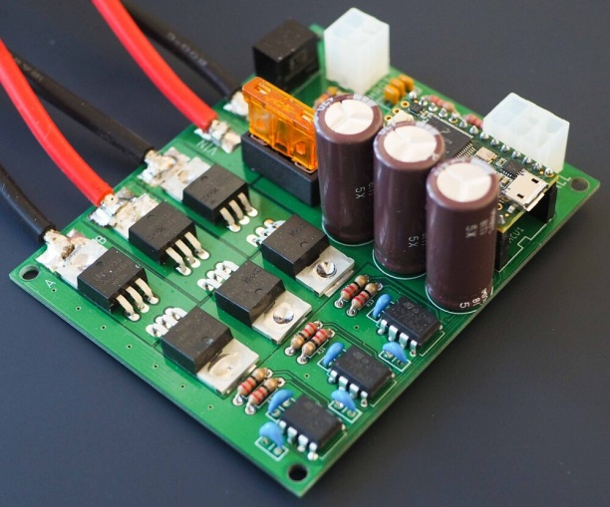
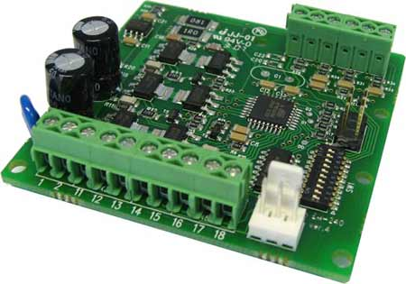
Driver circuits of BLDC motor …..
Vishwakarma Institute of Technology
FY - Department of Engineering, Sciences and Humanities

Slide 21
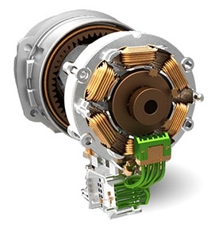
Applications of BLDC motor
CNC machines
Robotics
Position control systems
Electric vehicles
Washing machines
Hard drives of PC
DVD drives
Ceiling fans (new)
Blowers
Air conditioners
Refrigeration systems
Aeromodelling
Drones …… and many more ….
Vishwakarma Institute of Technology
FY - Department of Engineering, Sciences and Humanities

Slide 22
Actuators – 3.4
Brushless DC Motors
Thanks !
FY – DESH – VIT
Vishwakarma Institute of Technology
FY - Department of Engineering, Sciences and Humanities

